Slide 1
Modified Dextrans from Fina Biosolutions
Fina Biosolutions applies their expertise in carbohydrate conjugation to develop and manufacture high quality functionalized dextrans, including amino, carboxy, ”click” and fluorescent products. We offer a wide range of molecular weights and derivatization ratios as well as custom functionalized dextrans. We work with clients to assist them in finding the optimum dextran polymer for their application.
This note describes the use of a custom blue fluorescent dye-dextran conjugate used to image a beating Zebrafish heart.
Fina Biosolutions LLC
9430 Key West Ave Suite 200
Rockville, MD 20850
877 346 2246
Info@FinaBio.com www.FinaBio.com

Slide 2
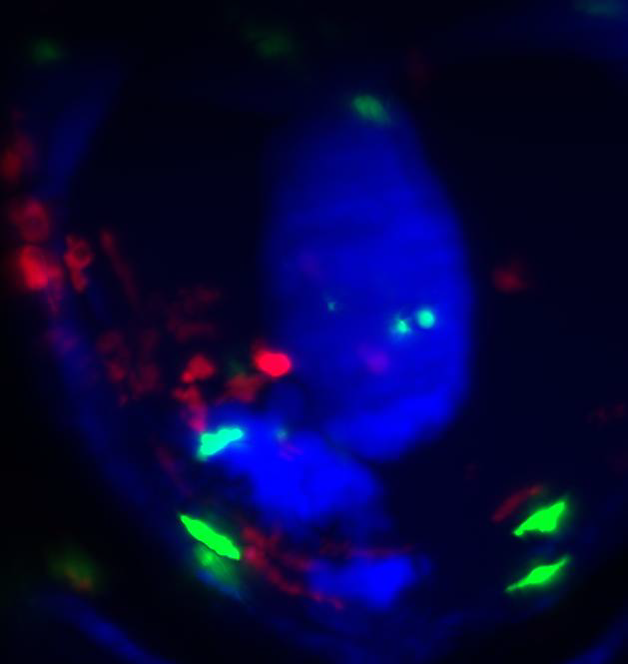
Macrophages
Neutrophils
Blood in the heart
Beating Zebrafish Heart
Courtesy of Mr Finnius Bruton
Centre for Cardiovascular science, University of Edinburgh
This is a movie of a beating embryonic zebrafish heart where the image acquisition has been synchronized to the heart beat [1] such that a ‘still’ heart can be observed.
Unlike the human heart which has four chambers, the zebrafish heart has just two, one ventricle and one atrium. This heart has been injured by a laser to induce a small wound at the ventricular apex.
The blood inside the hearts chambers has been stained by a blue fluorescent dye conjugated to dextran polymer. This allows us to so where the heart is. The objective of this experiment was to observe the interact between immune cells 1) neutrophils (green) and 2) macrophages (red) and the injured heart.
The neutrophils are fast moving and rapidly traverse to and from the injury. The macrophages are slower and crawl to the wound, staying there for the entire movie. The dextran dye eventually diffuses into the pericardial cavity, diluting it from the heart chamber and fading to black.
The blue fluorescent dye dextran conjugate was custom synthesized by Fina Biosolutions, Rockville, MD 20850. FinaBio.com
Atrium
Injury
Ventricle

Slide 3
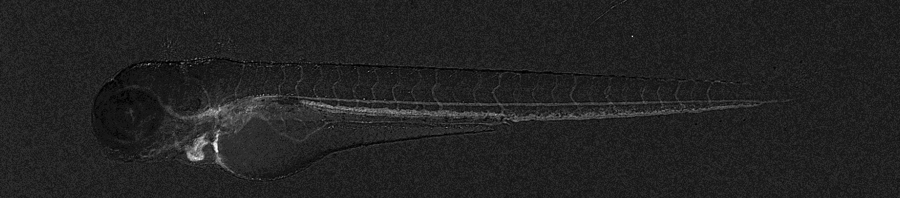
Fluorescent zebrafish embryo
This three day-old zebrafish embryo was injected with Pacific-Blue dextran fluorescent dye to make its blood fluorescent. Because these embryos are transparent, the vasculature is clearly visible.
Zebrafish embryo
Head
Tail
Blood vessels highlighted by dye
Heart
Injection with Pacific-Blue dextran dye

Slide 4
Pacific blue Dextran Hearts- Fluorescent scan
This is a light-sheet scan of an embryonic zebrafish heart. The heart muscle fluoresces red and the blood contains blue fluorescent dye which has been injected into the embryo.
This facilitates an appreciation of the heart wall and chamber.
mRFP
mRFP
Pacific Blue
Pacific Blue
Atrium
Ventricle

Slide 5
Pacific blue Dextran Hearts- 3D Surface Render
Fluorescence Scan
Surface-Render
Surface-Render
To gather a 3D impression of our scan we surface rendered the heart using the 3D information gained from the scan. We used IMARIS© software to perform the surface render.
mRFP
90 degrees
clockwise
Pacific Blue
References
1] High-resolution 3D optical microscopy inside the beating zebrafish heart using prospective optical gating. Taylor, J. M., Girkin, J. M., & Love, G. D. Biomedical optics express, 3(12), 3043, 2012
2]. Adaptive prospective optical gating enables day-long 3D time-lapse imaging of the beating embryonic zebrafish heart. Taylor JM, Nelson CJ, Bruton FA, Baghbadrani AK, Buckley C, Tucker CS, Rossi AG, Mullins JJ, Denvir MA . Nat Commun. 10(1):5173, 2019.

Slide 6
Overview of Functionalized Dextrans
X-dextrans
Z1-dextrans
X, Z1-dextrans
-X
-X
X-
X-
For more information visit: FinaBio.com
or contact us:
Info@FinaBio.com
-X
-X
X-
X-
-X
-X
Z1
Z1
Z2
Y-
-X
Z1, Z2-dextrans
X-
-Y
-X
-Y
X,Y-dextrans
X-
-X
Z1

